Slide 1
#twitterkurds
Lisa McInerney and Sean Looney
Dublin City University

Slide 2
Objectives
To map the online presence of Kurdish support for political violence
To explore their online strategies, choice of platforms, etc.
The explore the role of women within these online networks

Slide 3
#twitterkurds
Heavily-used hashtag
Gathered 5054 tweets for 4 week period from 17 Dec 2016 – 14 Jan 2017
Tweets which were not written in English were excluded
Dataset consisted of 1015 users
Users consisted of 213 Females, 33 Likely Female, 235 Likely Males, and 457 Males.
Remaining 77 Users gender unknown or organisational in nature.

Slide 4
Gendering User Profiles
Users were gendered based on appraisal of user profile by hand and divided into 5 categories.
M = Users with Male profile pictures/names on account.
F = Users with female profile pictures/names on account
LM = Users with profile pictures/bios which are likely male but without certainty.
LF =Users with profile pictures/bios which are likely female but without certainty.
U = Profiles which had no information relating to gender or belonged to organisations.
Notes:
Example: A user with the name ‘Fred Rosner’ and a profile picture of a man would be coded as M. Likewise a user with the name ‘Deb Daniels’ and a profile picture of a woman would be coded as F.
Once a user’s gender was not made obvious by their profile bio or profile photo a judgement was made on their gender based on
The content of their tweets.
What they chose to use a profile and cover photo in lieu of a picture of themselves.
Due to the uncertainty users coded as LF and LM were excluded from the analysis.

Slide 5
Lexicon: Male v. Female
1
2
3
4
5
6
7
8
9
10
11
12
13
14
15
16
twitterkurds | 1566
turkey | 460
kurdistan | 330
syria | 330
ypg | 327
kurdish | 309
isis | 308
turkish | 264
kurds | 216
ypj | 180
sdf | 174
rojava | 168
raqqa | 161
erdogan | 154
pkk | 101
iraq | 99
1
2
3
4
5
6
7
8
9
10
11
12
13
14
15
16
twitterkurds | 631
kurdistan | 275
kurds | 146
isis | 97
turkey | 95
rojava | 85
iraq | 80
kurdish | 77
stories | 60
turkish | 59
pkk | 56
ypg | 45
syria | 39
sdf | 38
hdp | 25
raqqa | 24
Subset of 1962 tweets from 457 Male Users
Subset of 860 tweets from 213 Female Users

Slide 6
Male v Female Discussion
Lexicon largely similar between Male and Female.
Avg. tweet frequency between M and F roughly the same; 4.03 (F) v 4.29 (M)
Both datasets concerned with two threats to Kurdistan: Turkey and ISIS.
Erdogan is heavily criticised in the male dataset whereas the female dataset rarely mentions him.
Notes:
Both M and F concerned with the two threats to Kurdistan: Turkey and ISIS. Iraq is heavily discussed in the male tweets but is absent in the female tweets. Erdogan is heavily criticised in the male dataset whereas the female dataset rarely mentions him.

Slide 7
External Links
 | Unique Domains | Number of Links
Traditional Media | 28 | 72
New Media | 35 | 497
Social Media/Blogs | 22 | 235
Government | 8 | 10
Academia | 12 | 17
File Hosting/Sharing | 4 | 57
NGOs | 4 | 4
 | Unique Domains | Number of Links
Traditional Media | 10 | 14
New Media | 15 | 212
Social Media/Blogs | 10 | 86
Government | 1 | 1
Academia | 2 | 2
File Hosting/Sharing | 3 | 4
NGOs | 0 | 0
 | Unique Domains | Number of Links
Traditional Media | 26 | 58
New Media | 30 | 285
Social Media/Blogs | 16 | 149
Government | 8 | 9
Academia | 10 | 15
File Hosting/Sharing | 2 | 53
NGOs | 3 | 3
Combined (M+F)
Female
Male

Slide 8
External Links Discussion
Outlinks appeared in 892 of 2822 ‘gendered’ tweets (31%)
Female users used out links proportionately more often (37% v. 29%)
Overall outlinks to New Media websites accounted for 55% of links.
Social Media/blogs was the second most popular at 26%.
Traditional Media Outlets were third with 8%.
This ranking held across the male and female datasets.
Notes:
‘Gendered’ = Tweets from either male users or female users with ‘Likely male’ and ‘Likely female’ excluded.

Slide 9
Domains
 | Unique Domains | Number of Links
New Media | 35 | 497
Social Media/Blogs | 22 | 235
Users linking to Social Media/Blogs and New Media websites linked to the same sites repeatedly.
Multilingual Kurdistan based New Media Outlets such as ANF News, Rudaw.net, and Kurdistan24 comprised the majority of New Media links.
Paper.li, a tool for collating articles and tweets into a virtual newspaper format, accounted for 76% of Social Media/blog links.
Notes:
Paper.li newspapers a possible suggestion for further research?

Slide 10
Top Male Sites Descriptions
http://paper.li Virtual 'Newspaper' creator. Tool to organise tweets and articles into a readable format for followers. (111)
http://www.anfenglish.com English version of Firat News Agency (ANF) a Kurdish news agency that gathers and broadcast news from the Middle-East. (Located in the Netherlands) (111)
https://www.youtube.com Google's video hosting/streaming site (52)
http://www.al-monitor.com News Agency focused on the Middle East in General (40)
http://www.kurdistan24.net independent and multilingual news agency based in Erbil, the capital of the Kurdistan Region of Iraq. (26)
http://aranews.net Independent press agency reporting on local developments across Rojava, Kurdistan Region, Syria, Iraq, Turkey and Iran. (21)
http://en.hawarnews.com English version Kurdish news agency that gathers and broadcast news from the Middle-East. (Located in Erbil) (19)
http://www.hurriyetdailynews.com Turkish Centre Left English Language Newspaper (18)
http://www.dailysabah.com Turkish Pro-government Newspaper (Multilingual) (10)
http://www.rudaw.net English version Kurdish news agency that gathers and broadcast news from the Middle-East. (Located in Erbil) (8)

Slide 11
Top Female Sites Descriptions
http://www.anfenglish.com/ English version of Firat News Agency (ANF) a Kurdish news agency that gathers and broadcast news from the Middle-East. (Located in the Netherlands) (165)
http://paper.li Virtual 'Newspaper' creator. Tool to organise tweets and articles into a readable format for followers. (68)
http://www.rudaw.net English version Kurdish news agency that gathers and broadcast news from the Middle-East. (Located in Erbil) (11)
http://aranews.net Independent press agency reporting on local developments across Rojava, Kurdistan Region, Syria, Iraq,Turkey and Iran. (7)
http://www.basnews.com independent and multilingual news agency based in Erbil, the capital of the Kurdistan Region of Iraq. (7)
http://www.kurdistan24.net independent and multilingual news agency based in Erbil, the capital of the Kurdistan Region of Iraq. (7)
http://linkis.com free link customization service for boosting social presence (5)
http://en.hawarnews.com English version Kurdish news agency that gathers and broadcast news from the Middle-East. (Located in Erbil) (4)
http://kurdishquestion.com Blog dedicated to Kurd issues, written by multiple authors (3)
http://www.independent.co.uk Left leaning British online newspaper (3)

Slide 12
Most Active Users M v F (tweets)
@c*******i | 264
@2*******r | 128
@H*****o | 101
@1********y | 48
@k*******e | 46
@e*******n | 162
@D*********i | 85
@z*******n | 55
@M******y | 34
@L*********e | 31
Male Users
Female Users

Slide 13
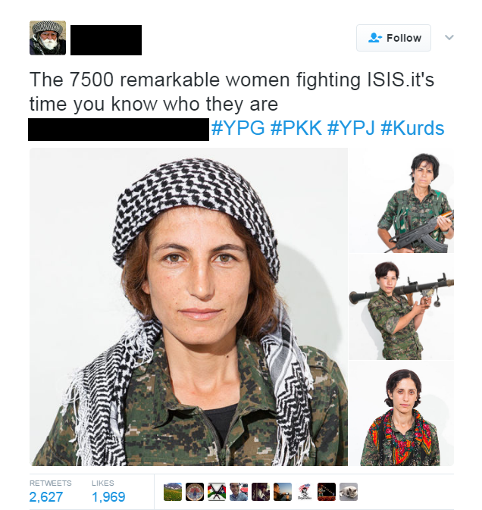
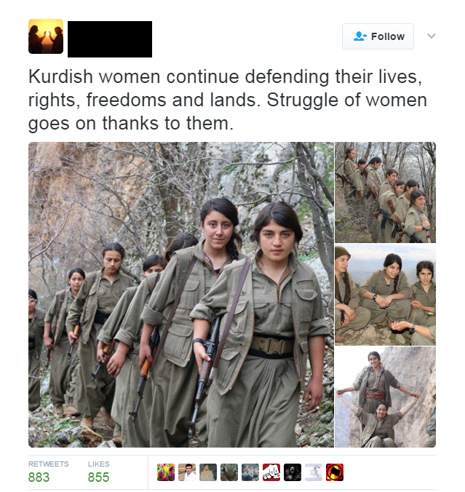
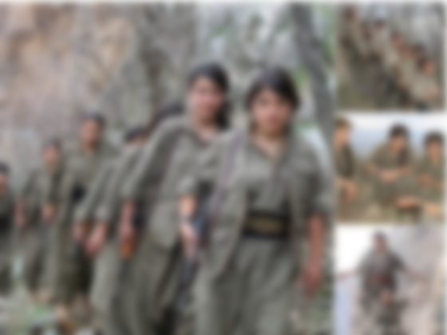
Pinned Tweets of Most Active Users
Notes:
Role of Kurdish women in fight against ISIS a prominent theme in #twitterkurds tweets. Most popular tweets from most active twitter accounts under the # (@curdistani and @em_bernadin) concern this theme.

Slide 14
Non Kurds using #twitterkurds
Notes:
However the theme is also hijacked by more right wing users to push an anti-immigrant/western feminism agenda.

Slide 17
Next Steps
Conclusion
Network Analysis
Identify key influencers
Comparative study of different groups/ideologies
Study of Virtual Newspapers created by paper.li

