Slide 1
New Methodological, Ethical, and Regulatory Considerations in Internet, Social Media, and Big Data Research
Charles Ess
Dr. Charles Ess
IMK, UiO
<charles.ess@media.uio.no>

Slide 2
Today’s Agenda
9:00-9:15: Welcome and Introductions
9:15-10:30: Charles and Ethics
Break
10:45-12:00: Elizabeth and Internet Research
12:00-1:00: Small Group Discussion or Large Group Discussion

Slide 3
0. Preliminaries
A range of ethical concerns and questions:
-- I also could not find a clear answer to the IRB office's question. It
seems that social media data as it relates to human subjects research is vague and/or complex. How has this research method, of using social media data, developed over the past few years? And, will this issue of human-subjects research likely become more complex and tedious (and, as such, render certain types of research past due and/or irrelevant)?
-- how to interact (if at all) with extremists in forums, on twitter etc. and problems of citation and informed consent.
-- how to delimit the basis for data collection, and what epistemological framework to use in comparing IS, AQ, and counterterrorist examples.
I want to write a methodology that justifies my inclusion of material, and addresses criticism of confirmation bias or 'cherry-picking'. …
[ethics ←→ methodology!]

Slide 4
0. Preliminaries
A range of ethical concerns and questions:
-- is it right to use scarce resources in a crisis area to do research? We thought humanitarian and practical aid concerns should come first, our research interests second. Was this the right decision?
On the other hand, network shutdowns used to counter uprisings and disconnecting certain platforms have become frequent in Turkey. Network shutdowns may harm human rights and undermine the capacity of oppressed populations to organize and speak up. Gathering research insights on network shutdowns might help to create awareness and find solutions to this problem.
And so on …

Slide 5
0. Preliminaries
The good news …
while certainly challenging and difficult in many ways, none of the questions explicitly raised and/or evoked (so far) are completely novel: on the contrary, they have been taken up - sometimes for a very long time indeed – in the relevant literatures, scholarly associations, etc.
one strategy here will be to highlight similar cases that thereby may offer suggestions for how to helpfully resolve a given ethical challenge or difficulty (“casuistics”);
We will also offer some additional resources for further reference and reflection, beginning with:
Ben Zevenbergen "Networked Systems Ethics," Oxford Internet Institute, <http://networkedsystemsethics.net/>
(part of an Open Technology Fund Fellowship: https://www.opentech.fund/)

Slide 6
0. Preliminaries
Broad approach:
1. Why it’s easy, why it’s difficult: large conceptual backgrounds: ethical judgment, ethical frameworks, ”meta-ethical” considerations
2. What’s your problem? Ways of thinking about research ethics
A. Persons or texts?
B. Methodologies ←→ ethics
C. Status of data: does “big data” / ”grey data” make a difference? Yes and no (OkCupid)
D. Dissemination ethics
E. Ethical variables: degrees of informed consent

Slide 7
1. Large conceptual backgrounds: ethical judgment, ethical frameworks, ”meta-ethical” considerations
A. the nature of ethical judgments
B. the range of ethical frameworks: utilitarianism, deontology
→ diversity of cultural / national traditions:
D. → Meta-ethical considerations: dogmatism – relativism - pluralism
Virtue ethics as “the new (very old) kid on the (ethical) block”

Slide 8
1. Introduction: why it’s easy, why it’s difficult …
A. the nature of ethical judgments – determinative judgment vis-à-vis reflective judgment/phronesis
determinative, “top-down” ethical judgments that run from (more or less) accepted general principles → specific ethical conclusion(s)
and
reflective, “bottom-up // top-down” ethical judgments that require us first to discern
(from the “bottom-up”) within a given, specific, fine-grained, and incomplete context of actors, relationships, and possible choices → what general ethical principles, norms, practices apply?

Slide 9
1. A. the nature of ethical judgments
determinative, “top-down” ethical judgments that run from (more or less) accepted general principles → specific ethical conclusion(s)

Slide 10
1. A. the nature of ethical judgments
reflective, “bottom-up // top-down” ethical judgments that require us first to discern
(from the “bottom-up”) within a given, specific, fine-grained, and incomplete context of actors, relationships, and possible choices → what general ethical principles, norms, practices apply?
An example … accept / decline a new academic position?
Context / factors in play …
Attractors | Drawbacks
Better salary desirable location new research / teaching / publication opportunities … | challenges of new position - including, e.g., new language costs of moving far from family, long-time friends …

Slide 11
Now: which factors are more significant - in light of what general norms, practices, values?
importance of friends?
importance of job, profession?
importance of family?
importance of money?
desire to experience new places?
Attractors | Drawbacks
Better salary desirable location new research / teaching / publication opportunities … | challenges of new position - including, e.g., new language costs of moving far from family, long-time friends …

Slide 12
1. A. the nature of ethical judgments
i) we can - with good reason, i.e., legitimately - discern
a) which general principles / norms / practices apply, and
b) in case of conflict, their relative weight / priority,
in part, precisely through a reflexive dialogical interrogation of a specific given context.
But this means:
ii) it is perfectly possible for different persons - or, e.g., the same person at different stages / contexts - to draw different judgments as to the proper course of action, e.g. “judgment calls”
iii) such judgments, moreover, may bring into play tacit, inarticulate understandings of the world and our place in it as developed through experience and known in and through the body
→ “gut feeling” “what my heart tells me” …

Slide 13
1. Introduction
(iv) This is the first (but only the first) reason why such judgments, finally, allow for a pluralism - i.e., a diversity of judgments may be legitimately made and rationally defended,
A second / third reason:
(B) the range of diverse ethical frameworks +
(C) (in part as these interweave with) diverse cultural / national traditions, approaches, norms, practices, etc.

Slide 14
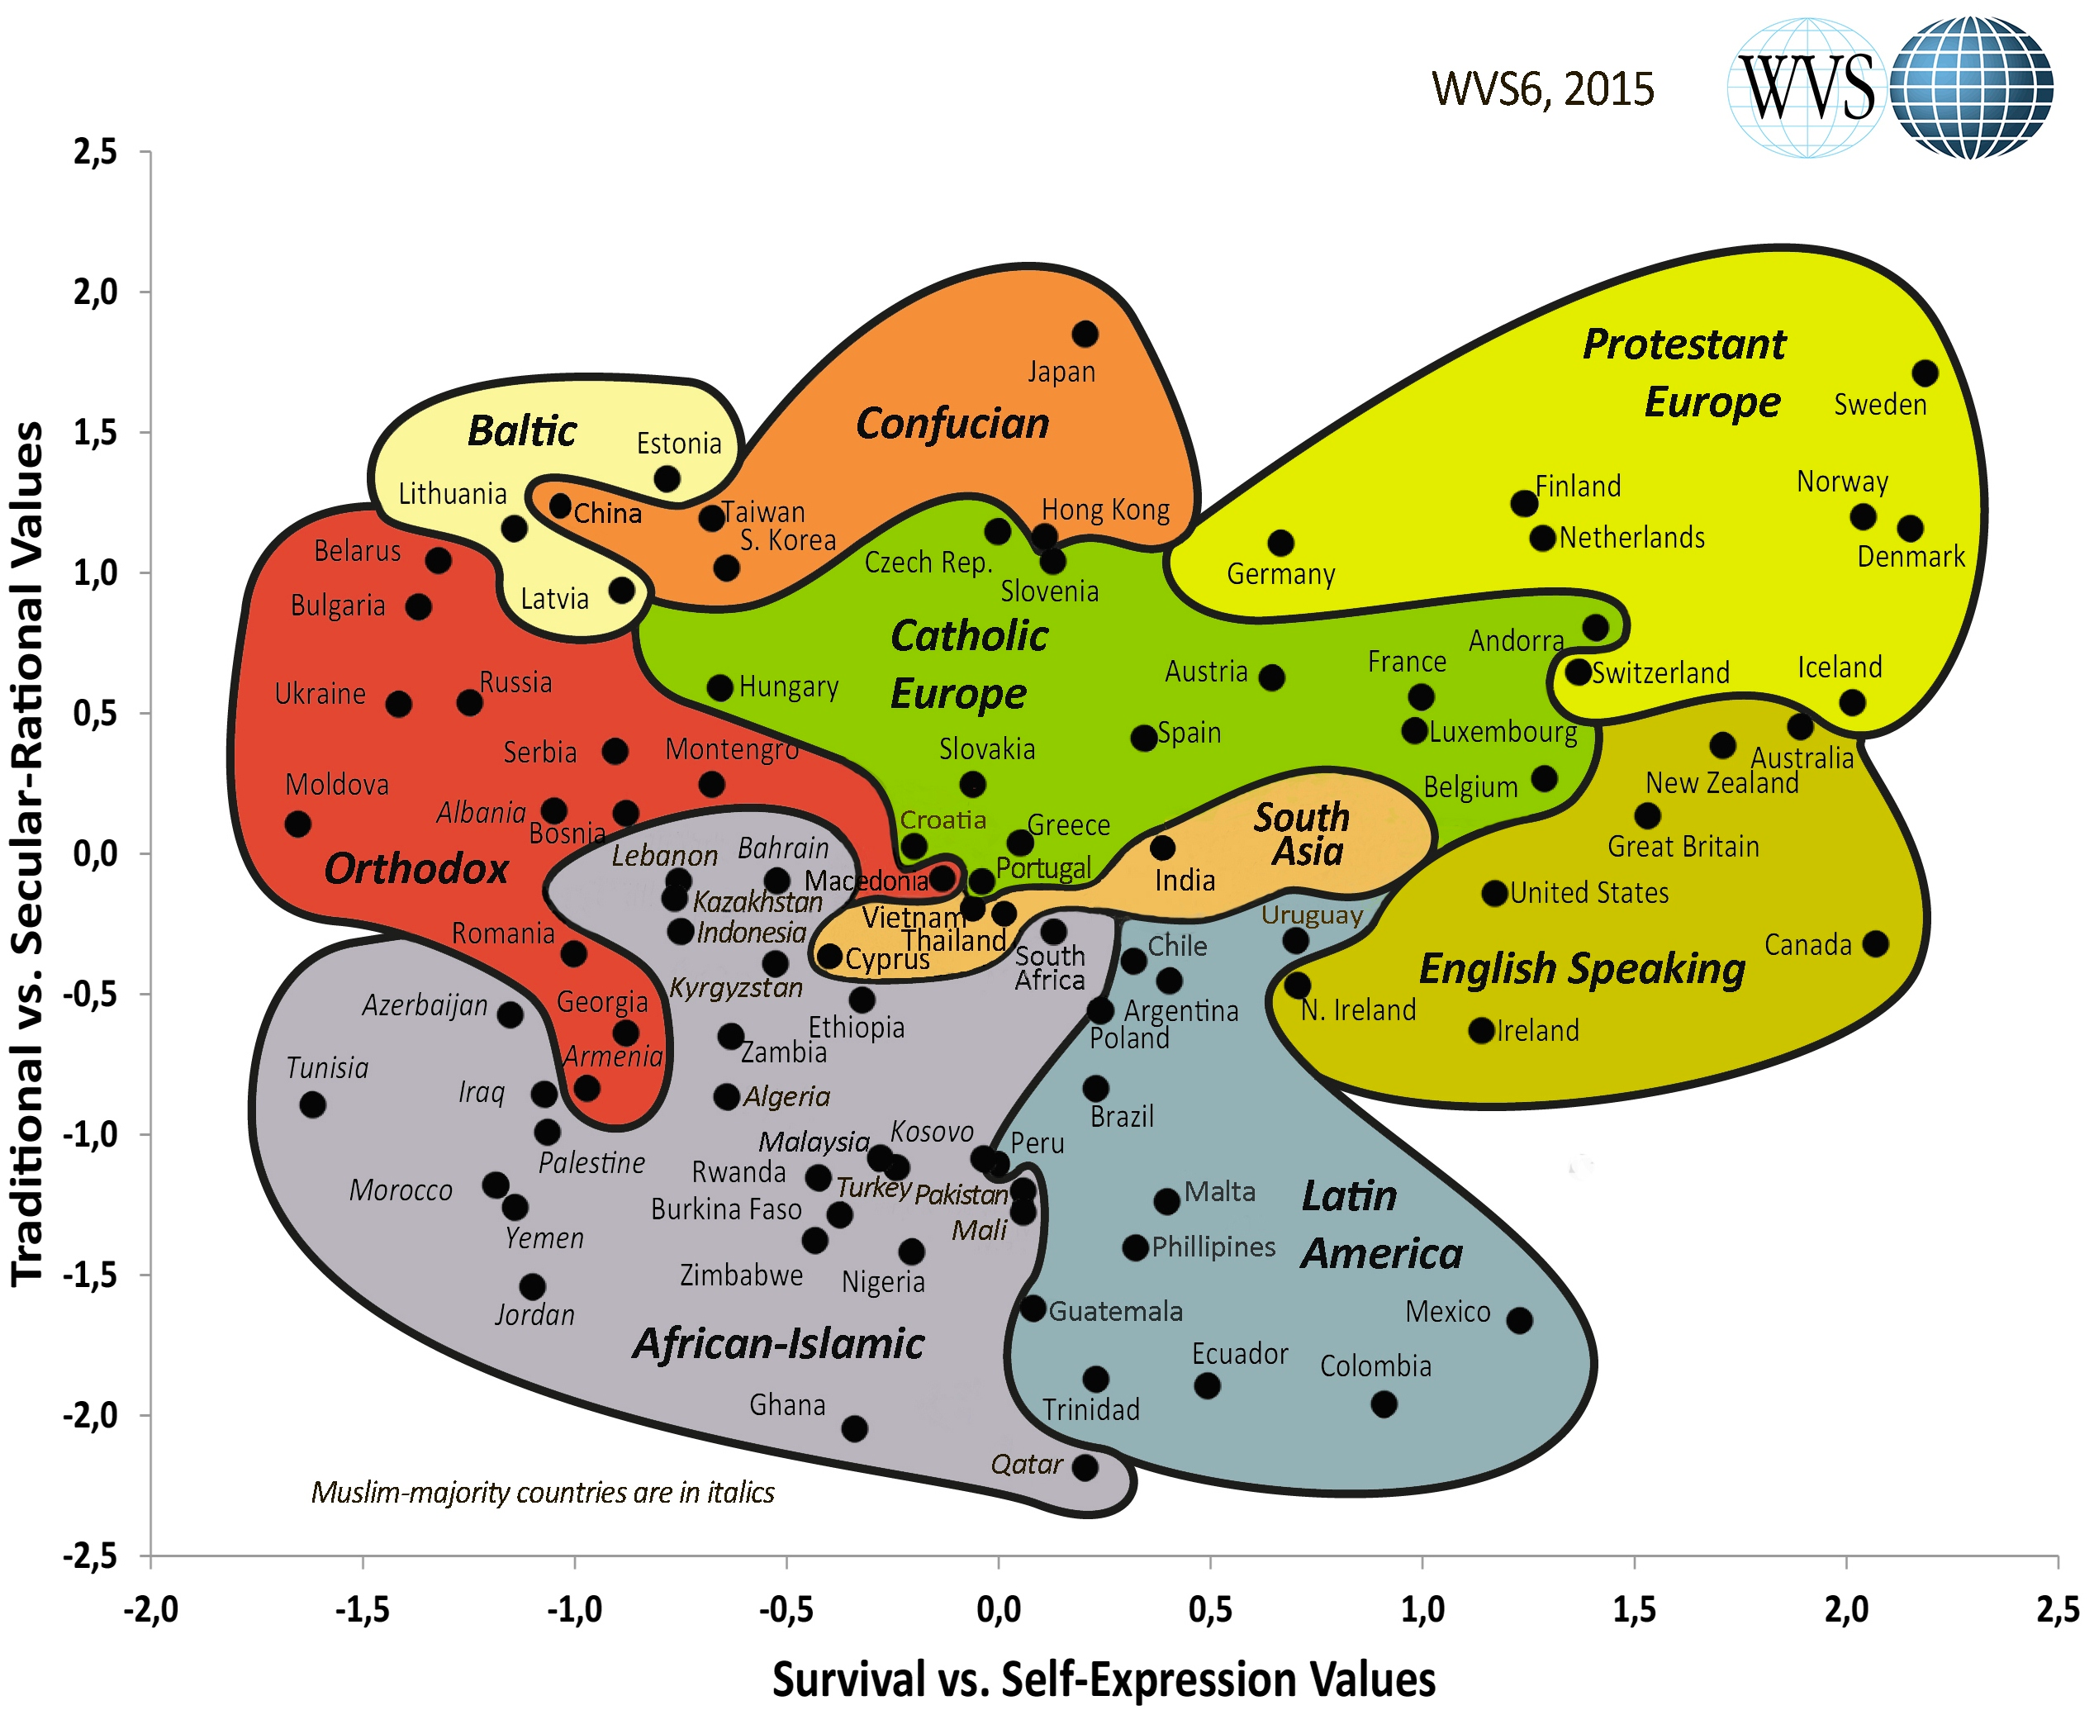
1. Introduction
(C) (in part as these interweave with) diverse cultural / national traditions, approaches, norms, practices, etc.

Slide 15
For example: the matters of privacy …
Linguistic-Cultural differences
“Privacy” in the U.S. as grounded in presumption of individual / personal spaces (including home – especially bathroom / bedroom) to be protected (e.g., against unreasonable searches, etc.)
Vis-à-vis
Privatlivet (“private life”) in Denmark, Norway, Germany and
the intimsfære (“intimate sphere”) of close personal relationships as what requires protection
→ “Privacy” as substantive, static – originally understood as anchored to specific spaces?
“Private life” as relational, fluid, subject to constant (re)negotiation processes?
→ Helen Nissenbaum (among others) and “contextual privacy”

Slide 16
1. B. (some) ethical frameworks
Utilitarianism – ethical cost-benefit analysis: will (potential) benefits of a given choice/act/rule outweigh possible harms (=costs)? “Greatest good for the greatest number” – primary framework in U.S. – UK?
Deontology – emphasizes basic rights of autonomous individuals (including life, liberty, pursuit of property … privacy, etc.) as near-absolute; to be protected (more or less) no matter what benefits might otherwise accrue. Strongly influential in Northern Europe, Scandinavia
      feminist ethics/ethics of care – feeling as much as reason is a crucial “way of knowing,” especially with regard to ethics as a matter of “sustaining the web of relationships”
      → “good Samaritan” ethics that goes beyond the minimal requirements of prevailing law, practices (Thomson 1971);
virtue ethics – what virtues (habit, practices, facilities) are requisite for the good life and community harmony? (“Eastern,” increasingly “Western”)
existentialism(s) – e.g., Existential Terrains: Memory and Meaning in Cultures of Connectivity <http://et.ims.su.se/>

Slide 17
Somewhat more carefully …
Utilitarianism and Deontology: two interwoven but distinct approaches to ethical decision-making
UTILITARIANISM
  … an ethical theory claiming that what makes behavior right or wrong depends wholly on the consequences….utilitarianism affirms that what is important about human behavior is the outcome or results of the behavior and not the intention a person has when he or she acts” (36: emphasis added, CE).
  (From: Deborah Johnson, Computer Ethics, 3rd. ed. Upper Saddle River, New Jersey: Prentice-Hall, 2001.

Slide 18
UTILITARIANISM
When faced with competing possible actions or choices, utilitarian approaches apply an ethical sort of cost/benefit approach, in the effort to determine which act will lead to the greater benefit, usually couched in terms of happiness (a notoriously difficult and ambiguous concept – thus making utilitarian approaches often difficult to apply in praxis).
species of utilitarianism (also called teleological or goal-oriented theories):
  ethical egoism: one is concerned solely with maximizing benefit or happiness for oneself (and/or)
  (act / rule) utilitarianism: maximize benefit or happiness for a larger group (hence the utilitarian motto of seeking “the greatest good for the greatest number”).

Slide 19
UTILITARIANISM
Simple example: impromptu beer and pizza / or fulfill your promise to help a friend with studying for an important exam?
 | Fulfill promise | Break promise – enjoy evening with friends
Costs (negatives) | Will miss a nice evening with friends … … … | Will disappoint a friend who’s counting on you … … …
Benefits (positives) | Will be able to help a friend in an important way … … … | Will enjoy a nice evening with friends … … …

Slide 20
UTILITARIANISM
Further examples of ”the good of the many outweigh the good of the few”
Warfare – e.g.,
  Soldiers
  The bombings of Canterbury / Hiroshima & Nagasaki
  → Individual privacy rights vs. ”national security”?

Slide 21
UTILITARIANISM
Weaknesses:
a) How do we evaluate possible consequences – e.g., assign quantitative numbers (”utils”)? (Further complicated by: what counts as pleasure / the good … physical … intellectual …?)
b) How far into the future must we consider –
And: the further into the future, the less certain our predictions …
c) For whom must we consider the consequences?
… the counterexample of slavery?

Slide 22
DEONTOLOGY [deon (duty) + logos (principle, account, science)]
Modern roots/traditions/expressions:
Kant:
  Respect for persons as rational autonomies capable of determining their own ends / rules;
always treat another person as an end-in-itself, never as a means
Rawls: “veil of ignorance” --> principles of equality, difference
Habermas: Communicative Rationality --> Discourse Ethics
feminist critiques / revisions, e.g., Seyla Benhabib
Ess: “Golden Rule” (Hillel / Jesus / Confucian …) approach (as consistent with participant/observer methodologies + feminist ethics)
Universal Human Rights, as in the UN Declaration (1948)?
Individual privacy rights vs. nation-state interests in national security?

Slide 23
→ Cultural differences
A. On the one hand, there appear to be cultural differences in terms of which of these theories we are more likely to apply – beginning with individual privacy rights:
e.g. EU Data Privacy Protection Guidelines
Directive 95/46/EC of the European Parliament and of the Council of 24 October 1995 on the Protection of Individuals with Regard to the Processing of Personal Data and on the Free Movement of Such Data.
<http://eur-lex.europa.eu/LexUriServ/LexUriServ.do?uri=CELEX:31995L0046:EN:HTML>

Slide 24
Data Subjects must
  Unambiguously give consent for personal information to be gathered online;
  Be given notice as to why data is being collected about them;
  Be able to correct erroneous data;
  Be able to opt-out of data collection; and
  Be protected from having their data transferred to countries with less stringent privacy protections. … etc.
These rights are (near) absolute, and (so far at least) cannot be overridden by state or business interests
→ Cf. recent “cookie legislation” + upcoming discussions for still more stringent individual data privacy protections

Slide 25
C. Cultural differences
B. By contrast …U.S. law, policy, as more oriented towards “the market,” stressing corporate/business rights over individuals (e.g., “shrink-wrap” licenses)
no such privacy protections:
rather, businesses are allowed to establish their own privacy policies, requiring the consumer to
  (a) inform him/herself of the policy and then
  (b) decide whether to agree or “opt-out”
a utilitarian emphasis on the (alleged) good of the many (minimal state intervention → greater economic efficiency) over possible violations of individual rights
And, after 9/11, “rights of due process” for state intrusion into individual privacy greatly weakened in the name of state-sponsored efforts to protect citizens against terrorism

Slide 26
(C) Multiple cultural / national ethical traditions …
Greater equality
Scandinavian / German / Dutch deontologies (Kant – Habermas)
Anglo-American utilitarianism / pragmatism
French moralism (Montaigne, Ricoeur)
Greater hierarchy
[Cf. Stahl, Bernd Carsten. 2004. Responsible Management of Information Systems. Hershey, PA: Idea Group.]

Slide 27
What to do in the face of diverse cultural-ethical traditions?
meta-ethical considerations:
Dogmatism – relativism – pluralism
  Ethical Dogmatism: one (set of) value(s) is correct, universally valid for all peoples and all times – and we know what that set of values is!
  Ethical Relativism: any (set of) value(s) is as legitimate as any other – relative to a given individual, culture, time/place, etc. No “universal values” exist, however.
  Ethical Pluralism: some value(s) are arguably more legitimate than others – many apparent ethical differences reflect diverse interpretations / applications / understandings of a shared value.

Slide 28
Pluralism – a first example:
Consider, for example whether or not your right to privacy (a general norm) means that I am allowed to take your photograph in a public space without your consent -
privacy
US - yes
Norway - no

Slide 29
→ Ethical pluralism as one meta-ethical response to differences, e.g.
First Principles
Privacy rights
  U.S.: liberal, market-based governance
  E.U.: socially-protective, rights-based governance
  (Riedenberg 2000, 1315)

Slide 30
E. Virtue Ethics as a global ethics?
…from Plato and Aristotle. The English word “virtue” in this context translates the Greek arete - better translated as “excellence.” In this tradition, “…ethics was concerned with excellences of human character. A person possessing such qualities exhibited the excellences of human goodness. To have these qualities is to function well as a human being” (Johnson 2001, 51).
  Contemporary feminist ethics / ethics of care /
  discourse ethics (Apel/Habermas) / dialogical ethics / “open source” ethics
  [AoIR, RESPECT processes]
  [recovery of premodern traditions]
  [movement towards global dialogue, ethics]

Slide 31
what sort of person do I want/need to become to be content (eudaimonia) – not simply in the immediate present, but across the course of my entire (I hope, long) life?
Along these lines: what sorts of habits should I cultivate in my behaviors that will lead to fostering my reason (both theoretical and practical) and thereby lead to greater harmony in myself and with others, including the larger natural (and, for religious folk, supernatural) orders?
Or, from Shannon Vallor – what practices do I need to pursue in order to acquire the virtues of patience, perseverance, empathy, trust, etc. as these are necessary for deep friendships, long-term commitments to a spouse, parenting, etc.?
Consider: short and fast texts, video games (e.g., FPS, “Rapelay,” etc.)
A) what virtues or excellences do these help us practice and acquire?
B) what virtues or excellences do I neglect, fail to practice?

Slide 32
Why virtue ethics now?
A strong candidate for a global information and computing ethics:
Global roots: an ethics that is found (more or less) in every recorded ethical tradition “East” and “West”, both ancient and modern;
Pluralistic – multiple traditions → multiple expressions that reflect and preserve specific cultural traditions and preferences;
Non-”religious” – can be affirmed in thoroughly “secular-rational” fashion and venues, beginning with the Enlightenment + (re)emerging educational traditions of Bildung, dannelse (cf. U.S. liberal arts-based education)
→ perhaps, a global media and communication ethics?

Slide 33
1. E. Virtue Ethics as a global ethics?
Work package X: The Good Life in the digital era (“Onlife 2.0”)
“flourishing,” “the good life” as
1. Foundational to Information and Computing Ethics (ICE), beginning with Norbert Wiener, “father of cybernetics” + The Human Use of Human Beings (1950/1954) → ICE, including philosophy and computing conferences IACAP / CEPE / ETHICOMP
2. bridge terms, shared thematics with media and communication, e.g., ICA 2014 + theme volume

Slide 34

E. Virtue Ethics as a global ethics?
“flourishing,” “the good life” as
3. Central to rapidly growing areas of research and publication, including research and design of new ICT technologies:
Sarah Spiekermann, Ethical IT Innovation: A Value-Based System Design Approach (2016, Taylor & Francis)
“value-sensitive design” – centrally focused on eudaimonia (contentment)
see: C. Ess, The Good Life: Selfhood and Virtue Ethics in the Digital Age. In Helen Wang (ed.), Communication and the Good Life (ICA Themebook, 2014), 17-29.

Slide 35


1. E. Virtue Ethics as a global ethics?
Major difficulties:
A) shift from (strongly) autonomous / individual sense of self → relational self
→ B) (re)turn to subordination of the self to larger communities of relationship as hierarchical, non-democratic.
So Macintyre: VE → submit and obey:
A practice involves standards of excellence and obedience to rules as well as the achievement of goods. To enter into a practice is to accept the authority of those standards and the inadequacy of my own performance as judged by them. It is to subject my own attitudes, choices, preferences and tastes to the standards which currently and partially define the practice. (1994: 190; emphasis added, CE).
→ (feminist) relational autonomy as counter?

Slide 36
1. E. Virtue Ethics as a global ethics?
1. (feminist) relational autonomy
recognizes that “Some social influences will not compromise, but instead enhance and improve the capacities we need for autonomous agency” (Westlund 2009, 27).
is further interwoven with the defining goals of virtue ethics: “autonomy is one primary good among others that a person needs to live a good life or to achieve human flourishing” (Veltman and Piper 2014, 2).
At the same time, Veltman explicitly conjoins virtue ethics with a Kantian deontological account of autonomy that grounds respect for persons as a primary value.

Slide 37
1. E. Virtue Ethics as a global ethics?
2. Virtue ethics: embodiment and loving as a virtue (Ruddick 1975)
phenomenological accounts that stress the role of embodiment in defining our identities in non-dualistic ways (1975, 89).
foregrounds loving itself as a virtue – i.e., a practice that can be difficult at times and one that requires attendant commitments, including a Kantian respect for persons and thereby equality (1975, 98f).
[→ “complete sex” as marked by these norms and virtues, coupled with mutuality of desire – “desire desiring desire,” my desire that my desire be desired by the Other]

Slide 38
AND: this is going to complicate (Internet) Research Ethics!
(Internet) research ethics as the specific project to protect the research subject as an autonomous individual with a right to privacy (and so confidentiality, anonymity, etc.),
BUT from the perspective of either ….
autonomous individual
(Further consequences)
Consideration …
→ Choice …
→ Action(s)
X
Utilitarianism
focus on consequences of acts
“risk / benefit” analysis
“balance” of risk to subject(s) vs.
(potential) benefits to society
Deontology
e.g. Kant:
capacity to give oneself one’ own rule (auto-nomos)
→ respect for Others “always as ends, never as means only”

Slide 39
Complication for IRE: shifting emphasis from individual to relational self//identity
(larger communities / networks)
(close ties / intimsfære / privatlivet)
Virtue Ethics
practices, habits
e.g., patience, perseverance, empathy
that establish, foster relationships, e.g., friendship (Vallor 2009, 2011, 2012)
(weak ties)
relational self: relational autonomy /
webs of relationships …
autonomous individual
X
(Further consequences)
Consideration …
→ Choice …
→ Action(s)
Deontology
Utilitarianism

Slide 40
iii) Changing conceptions of selfhood ←→ privacy / privatlivet
What kind(s) of “privacy” / privatlivet?
Nissenbaum (1998; 2004; 2010; 2011) builds her account on James Rachel’s theory of privacy –
a relational (or, alternatively, social) understanding of selfhood.
Rachels demarcates a defining connection between privacy expectations, on the one hand, and specific social roles, on the other, such as “businessman to employee, minister to congregant, doctor to patient, husband to wife, parent to child, and so on” (Rachels 1975: 328, cited in Nissenbaum 2010: 65, 123).
→ contextual integrity based on the norms of information flow and on the idea that one engages in self-disclosure within a context that involves situational expectations of privacy
→ privacy rights defined in terms of flows of information as “appropriate” to a given context:

Slide 41
iii) Changing conceptions of selfhood ←→ privacy / privatlivet
A first approximation? NESH 2006
13. The obligation to respect individuals’ privacy and close relationships
Researchers shall show due respect for an individual’s privacy. Informants are entitled to be able to check whether confidential information about them is accessible to others.
Respect for privacy aims at protecting individuals against unwanted interference and exposure. This applies not only to emotional issues, but also to questions that involve sickness and health, political and religious opinions, and sexual orientation.
Researchers should be especially compassionate when they ask questions that involve intimate issues and they should avoid placing informants under pressure. What is perceived as sensitive information can vary from one individual or group to the next.
Distinguishing between the private and public spheres can sometimes be difficult when it comes to information about behaviour that is communicated and stored on the Internet. When using material from such interactions, researchers must pay sufficient attention to the fact that people’s understanding of what is private and what is public in such media can vary. (NESH 2006 B.13, p. 17)

Slide 42
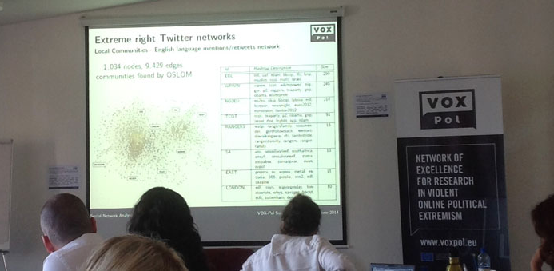
1.C You can’t always get what you want …
While there are often methodologically sound and ethically legitimate / justified ways of (re)solving the ethical challenges raised in a given research project –
occasionally there are not: sometimes the answer is “no”
E.g.
(earlier?) “no-go” areas: pro-ana, cutting, suicide sites …
danger(s) to researchers – retribution from informants, colleagues, angered by published findings, etc.
Also: “middle ground problems” – what are researchers’ responsibilities when they uncover information that suggests imminent/possible harm to either an informant or someone else?
→ legal and professional ethical requirements, etc
→ international projects: which national laws do we follow re. encryption and secure storage of data?

Slide 43
1. Introduction
In sum: given
1) the range of possible ethical decision-making procedures (utilitarianism, deontology, virtue ethics, feminist ethics, etc.),
2) the multiple interpretations and applications of these procedures to specific cases, and
3) their refraction through culturally-diverse emphases and values across the globe
– ethical issues – both broadly (“what is the meaning of life”) and as raised by Internet research - are ethical problems precisely because they evoke more than one ethically defensible response to a specific dilemma or problem. Ambiguity, uncertainty, and disagreement are inevitable.
The best we can do: general guidelines + case histories (casuistics) → possible resolutions (not “solutions”) of specific ethical challenges, dilemmas. (So AoIR 2002, 2012)

Slide 44
2. What’s your problem? Ways of thinking about research ethics
A. Persons or texts?
B. Methodologies ←→ ethics
C. Status of data?
D. Dissemination ethics
E. Ethical variables: degrees of informed consent

Slide 45
2.A. issues based on conceptions of identity and ethical agency
as focused on the (inter-)actions of persons, understood to have basic rights (including the rights to privacy and protection from harms).
In the “standard model” of research Human Subjects Protections, these rights are further specified in terms of
confidentiality
anonymity
informed consent - specifically as intended to protect ethical autonomy (cf. Swedish Research Council’s Ethical Research Principles, Rules 1-3)
→ what McKee & Porter call a “person-based” view of research
vis-à-vis: issues of ownership -
copyright and other matters of authorial control over one's texts
what McKee & Porter call a “text-based” view of research

Slide 46
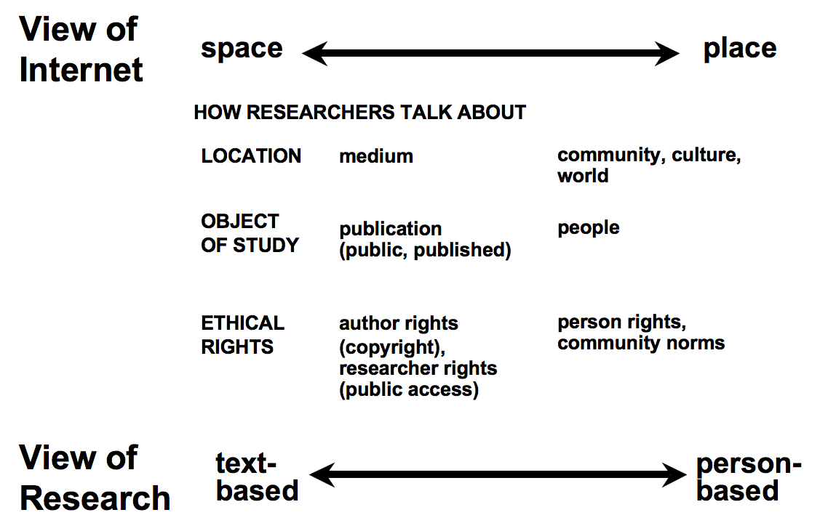

Slide 47
2.B. Methodologies ←→ Ethics
Participant-observation + discourse analysis heighten the importance of privacy, informed consent, and attending to the ethical issues surrounding the use of participants’ texts:
As participant-observation emphasizes more personal, empathic relationship → increases researchers’ inclination to accord higher degrees of privacy protection (“Golden Rule” and/or “Good Samaritan Ethics”)
+ pragmatic recognition that participants can easily disconnect from online engagements, increasing the importance of a “trusted, reciprocal exchange” (feminist) Oliver & Lunt 2004, 107)
Cf. McKee and Porter, 2009:
in addition: grounded theory (Glaser and Strauss, 2010) + “reflexivity” (Alvesson, 2003; Finlay, 2002) → on-going ethical reflection, negotiation with participants / informants
Alvesson, M. (2003). Beyond neopositivists, romantics, and locallists: A reflexive approach to interviews in organizational research. The Academy of Management Review, 28(1), 13-33;
Finlay, L. (2002). Negotiating the swamp: the opportunity and challenge of reflexivity in research practice. Qualitative Research, 2(2), 209-230.

Slide 48
2.C. Status of Data ...
Beginning with (again): How to think about “privacy”? Early models
Non-sensitive
Large chat room;
users informed from the outset that exchanges are not confidential; anonymity-privacy protected → no need for informed consent (Kraut et al 2004)
Private (smaller community / country)
Public
(larger community / country)
Small GLBT listserv in Norway: informed consent requested from group; posters anonymized; direct quotes only with permission (Bromseth 2005)
Off-limits?
“Pro-anas,” AIDS/HIV” listservs …
Sensitive

Slide 49
2.C. Status of Data ...
the status of data (public? private? …?) provided in social networking profiles
Terms of service?
Local / international laws?
Expectations of users / community / author? (→ “good Samaritan ethics”)
additional questions:
How do the terms of service articulate privacy of content and/or how it is shared with 3rd parties ?
Does the author/participant consider personal network of connections sensitive information ?
How is profile or location information used or stored by researcher ?
Does author/participant understand and agree to interaction that may be used for research purposes ?
Does research purpose and design balance possible conflicts between participant and researcher perceptions of public/private and sensitive/nonsensitive ?

Slide 50
2.D Dissemination Ethics and Informed Consent
-- especially with regard to profile data and blog posts.
AoIR 2.0 questions:
Does the dissemination of findings protect confidentiality ?
Is the data easily searchable and retrievable ?
If the content of a subject’s communication was ever linked to the person, would harm likely result ?
Additional considerations: composite / aggregated identities …
and “fabrication” (? – warning!)
Markham, A. 2012. Fabrication as ethical practice: Qualitative inquiry in ambiguous internet contexts. Information, Communication & Society 15(3): 334-353.

Slide 51
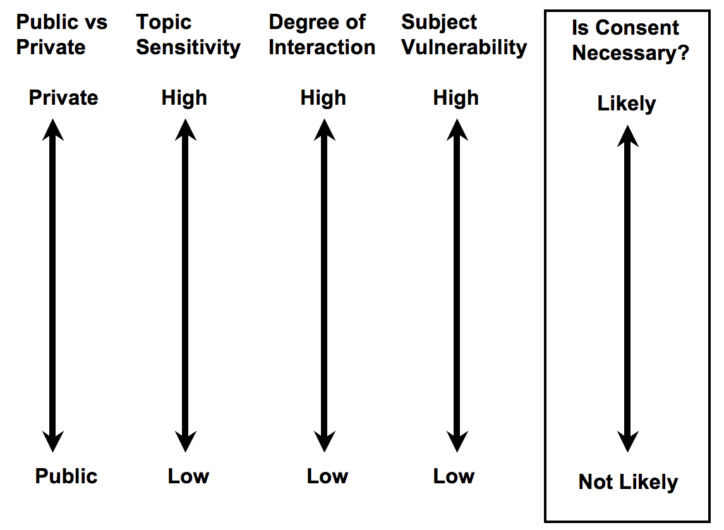
2.E. Ethical variables and degrees of informed consent

Slide 52
Additional examples
Yukari Seko (PhD student, communications, York University, CA): studied an online forum and blogs for people with suicidal and self-hurting tendencies. Particular difficulties with one young blogger who wrote frequently about own suicide.
Laurie Cubbison (assistant prof., rhetoric & writing, Radford University, USA): studied medical patient support groups develop rhetorical strategies for communicating their views of illness to doctors, support persons, general public. Participant-observer, argues for an ethic of care in research and reporting.
Janne Bromseth (cultural, media researcher, Stockholm): studied gendered and sexual identity expression in a listserv for lesbian and bisexual women. Participant-observer, especially sensitive to risks and problems of such women in more conservative, more rural areas of Norway – as itself a relatively small country.
-- McKee & Porter 2009: 76

Slide 53
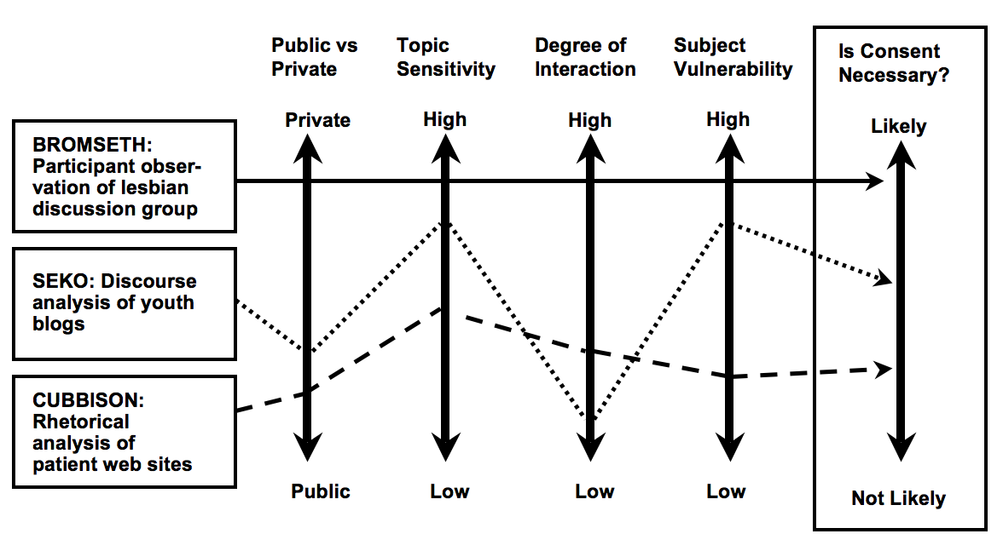
What counts as ”sensitive”?

Slide 54
2.E. Ethical variables and degrees of informed consent
Patricia Lawson offers a range of possible options that researchers can offer to participants:
(1) consent to having their nickname and communicative text used for data analysis only (no publication of name or text);
(2) consent to having either their nickname or text published in an academic work, but never together (i.e., no identifiers);
(3) consent to having either their nickname or text published in an academic work, but never together (i.e., no identifiers) and providing they get to see the “write up” prior to publication;
(4) consent to having both their nickname and text published in academic work, thereby being credited as the authors of their own words or
(5) consent to having both their nickname and text published in academic work, thereby being credited as the authors of their own words, providing they get to see the “write up” prior to publication. The last two options deal directly with the issue of CMC copyright. (2004, 93)

Slide 55
Informed Consent – helpful variations?
Lawson
(strong)
5
4
3
2
1
(weak)

Slide 56
Thank you!
Dr. Charles Ess
IMK, UiO
<charles.ess@media.uio.no>

